Slide 1
Azure Machine Learning
Introduction using the AML Learning Studio

Slide 2
Azure Machine Learning
Azure Machine Learning is a cloud predictive analytics service that makes it possible to quickly create and deploy predictive models as analytics solutions. Getting started is easy. The first working prototype is an easy evening project. But Azure Machine Learning will grow to extremely complex projects. This session will demonstrate initial projects utilizing multiple data science principals.

Slide 3

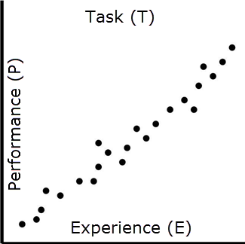
The Machine Learning Paradigm
“ A computer program is said to learn from experience (E) with respect to some class of tasks (T) and performance measure (P), if its performance at tasks in T, as measured by P, improves with experience E. ”
~Tom Mitchell
Machine Learning is the “Extraction of Wisdom by Understanding the underlying Data”
Source: Tom Mitchell, Mitchell, T. (1997). Machine Learning, McGraw Hill.
Mark Reynolds, compilation

Slide 4
Buzzwords
Buzzwords for 2017 / 2018
Buzzwords for 2019
Big Data
Machine Learning
Prescriptive Analytics
Blockchain
Tensor Flow
Vision
IoT
Cloud
Cognition
Blockchain
IoT
Machine Learning
Source: Mark Reynolds, compilation
Notes:
Last year, Big Data was at the top of the Garner chart. This year it was replaced by Machine Learning. Blockchain and Tensor Flow are the newest buzzwords.

Slide 5
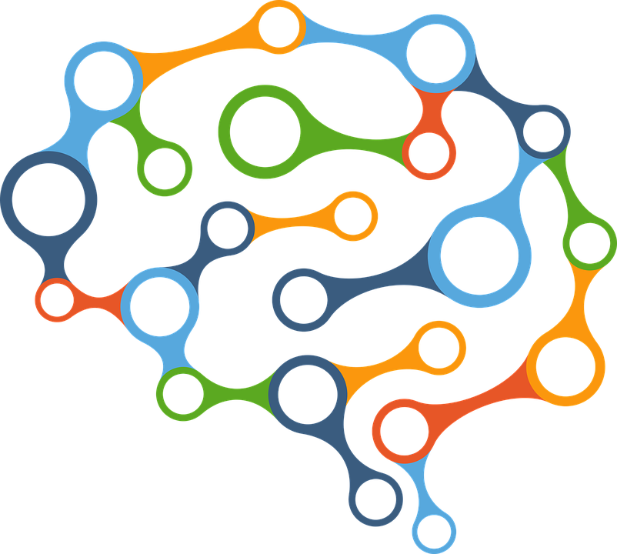

The Shifting Computing Paradigm
2017
2019
Traditional Science
Empirical
Theoretical
Computational
Data Exploration
Years
10s Years
100s Years
eScience
1000s Years
Descriptive and Formulaic
Hypothetical and Investigative
Multivariant Differential Modelling
Expertise Driven Models and Cases
Source: Mark Reynolds, compilation
Notes:
The four paradigms are
Empirical --- Isaac Newton
observations were descriptive and formulaic
Describes natural phenomena
Theoretical --- Albert Einstein
the quintessential theorist
Computational --- John McCarthy
1979 article “Ascribing Mental Qualities to Machines”
Data Exploration / eScience --- Jim Gray
“Where IT meets Science”
set of tools and technologies to support data federation and collaboration for analysis, data mining, data visualization and exploration, and for scholarly communication and dissemination

Slide 6
Analytics, Applied
Hindsight
Insight
Foresight
Descriptive Analytics
Diagnostic Analytics
Predictive Analytics
Prescriptive Analytics
What happened?
Why did it happen?
What will happen next?
What can we do about it?
Document and File
Tabulate and Summarize
Chart and Plot
Process and Analyze
Data
Information Visualization
Knowledge Forensics
Understanding Analysis & Mining
Wisdom Anticipating
Application
Source: Mark Reynolds, compilation
Notes:
In the 4th paradigm, we’ll embrace Machine Learning following the enhanced DIKW pedagogy
Acquire
Analyze
Annunciate
Archive
Analyze
Anticipate
Apply

Slide 7
The Machine Learning Paradigm
Predictive Analytics
Machine Learning
Data Mining
AI
24/7
Beware of the 90-foot discovery!
Beware of extreme data vetting!
Supervised Learning
Unsupervised Learning
Reinforcement Learning
Semi-Supervised Learning
Beware of rabbit holes!
Beware of brittleness from over tweaking!
Source: Mark Reynolds, compilation

Slide 8
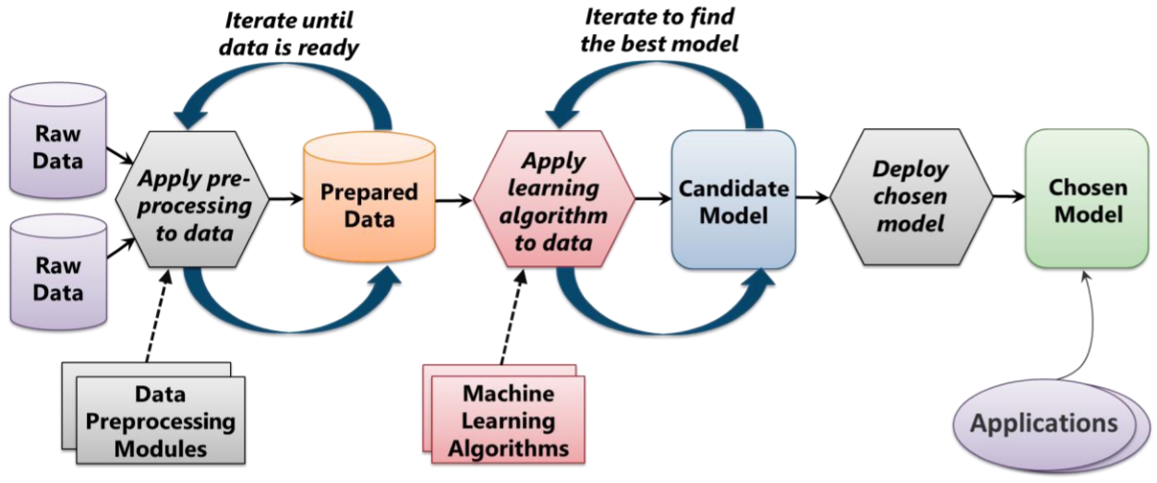
The Machine Learning Process
Source: Introduction to Azure, David Chappel

Slide 9
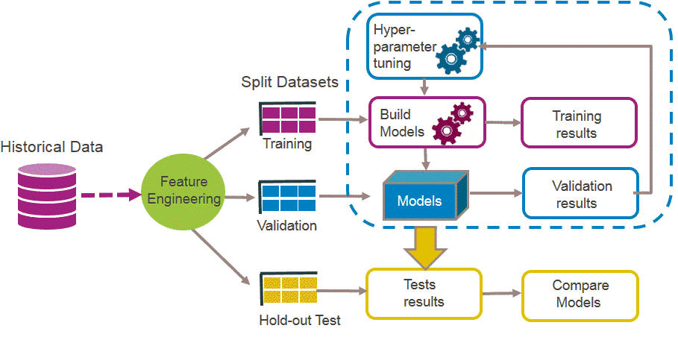
Validating and Applying Successes
Source: Machine Learning has transformed many aspects of our everyday life, can it do the same for public services?, Natalia Angarita , May 23, 2016, Capgemini https://www.capgemini.com/blog/insights-data-blog/2016/05/machine-learning-has-transformed-many-aspects-of-our-everyday-life

Slide 10
Common Algorithmic Approaches
Decision Tree Learning
Maps observation to conclusions
Association Rule Learning
Discovering interesting relations
Artificial Neural Networks
Incremental function modules
Inductive Logic Programming
Rule based representations for input --> output
Support Vector Machines
Classification and regression
Clustering
Assignment of observations to clusters
Bayesian Networks
Probabilistic models correlating variables
Reinforcement Learning
Finds policy to map states to desired outcome
Representation Learning
Principal component analysis
Similarity & Metric Learning
Pairs of examples train others
Sparse Dictionary Learning
Datum as linear combinations
Genetic Algorithms
Mimics natural heuristics
Source: Mark Reynolds, compilation

Slide 11
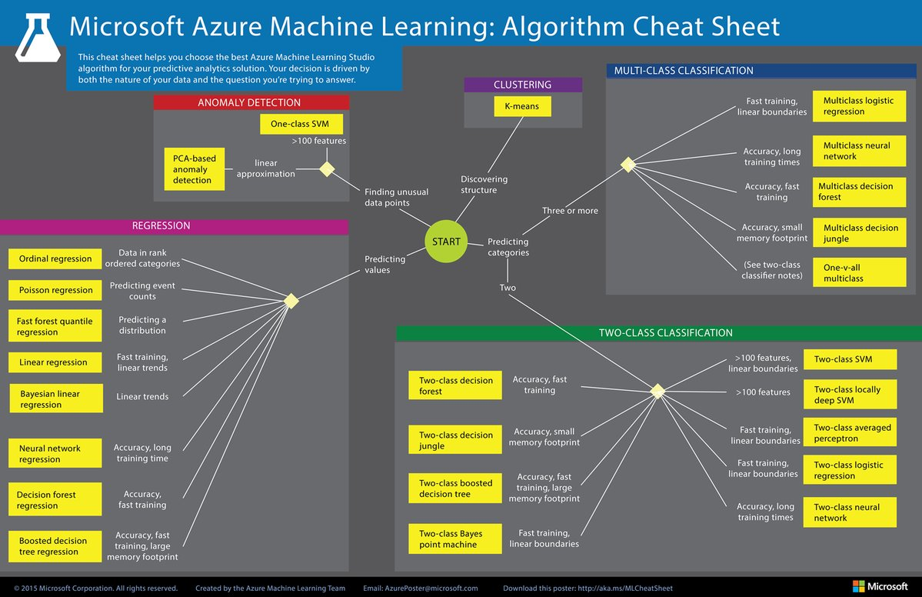

Slide 12
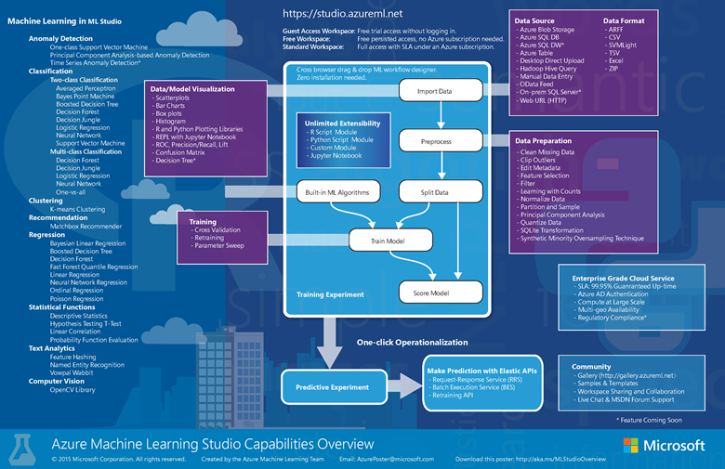

Slide 13
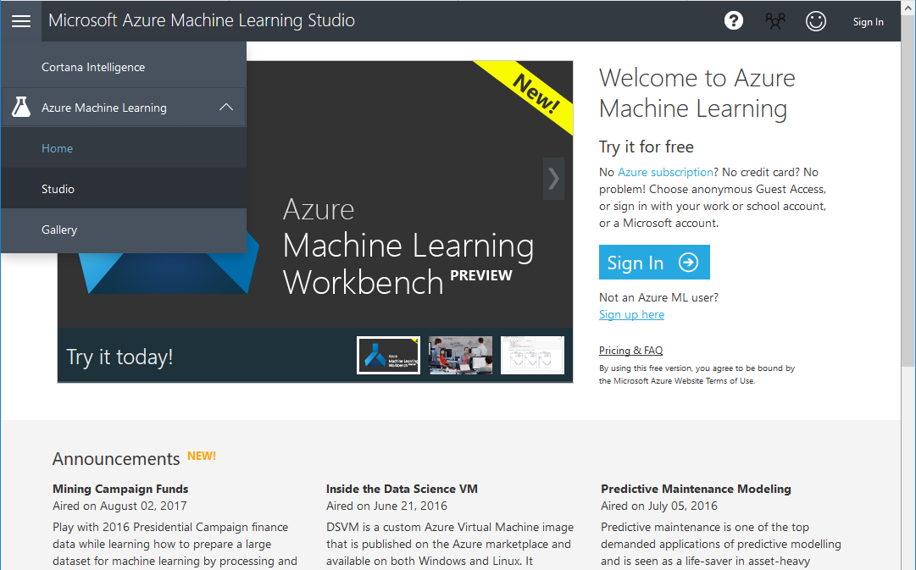
https://studio.azureml.net/

Slide 14
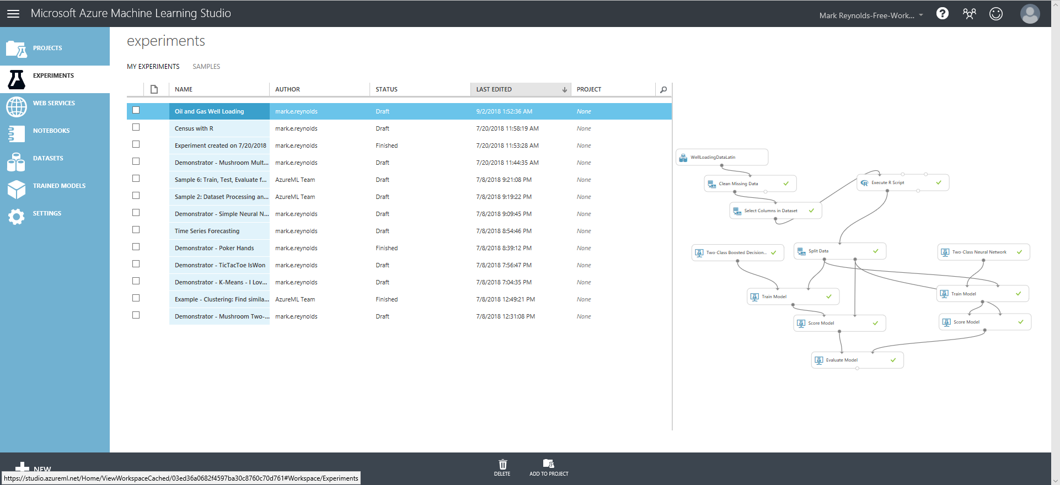
Azure ML Development Workspace

Slide 15
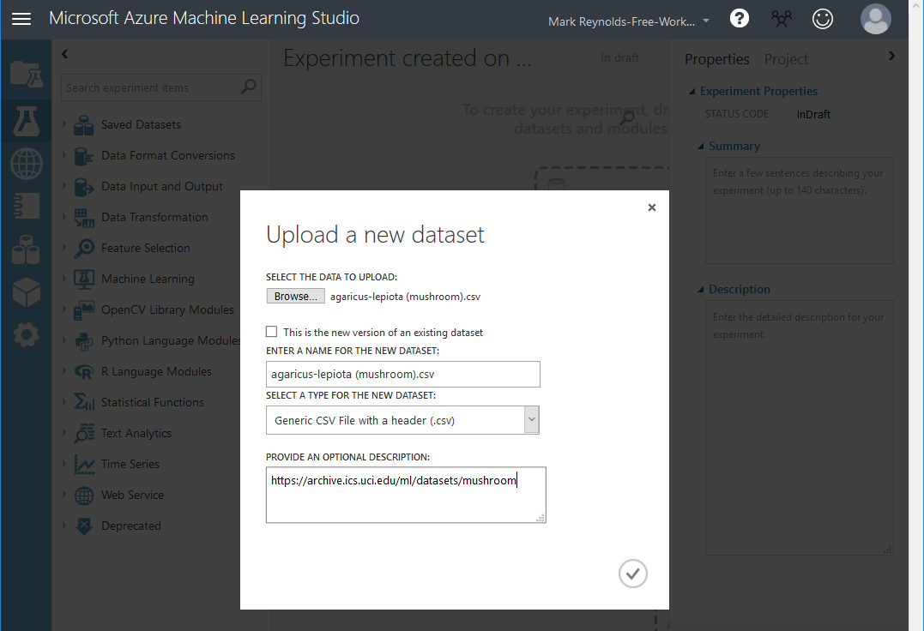
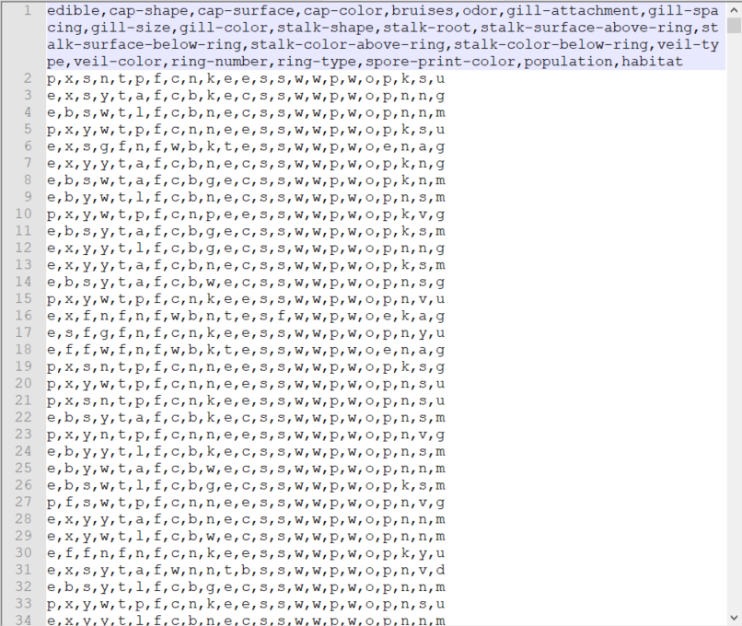
New Mushroom Project

Slide 16
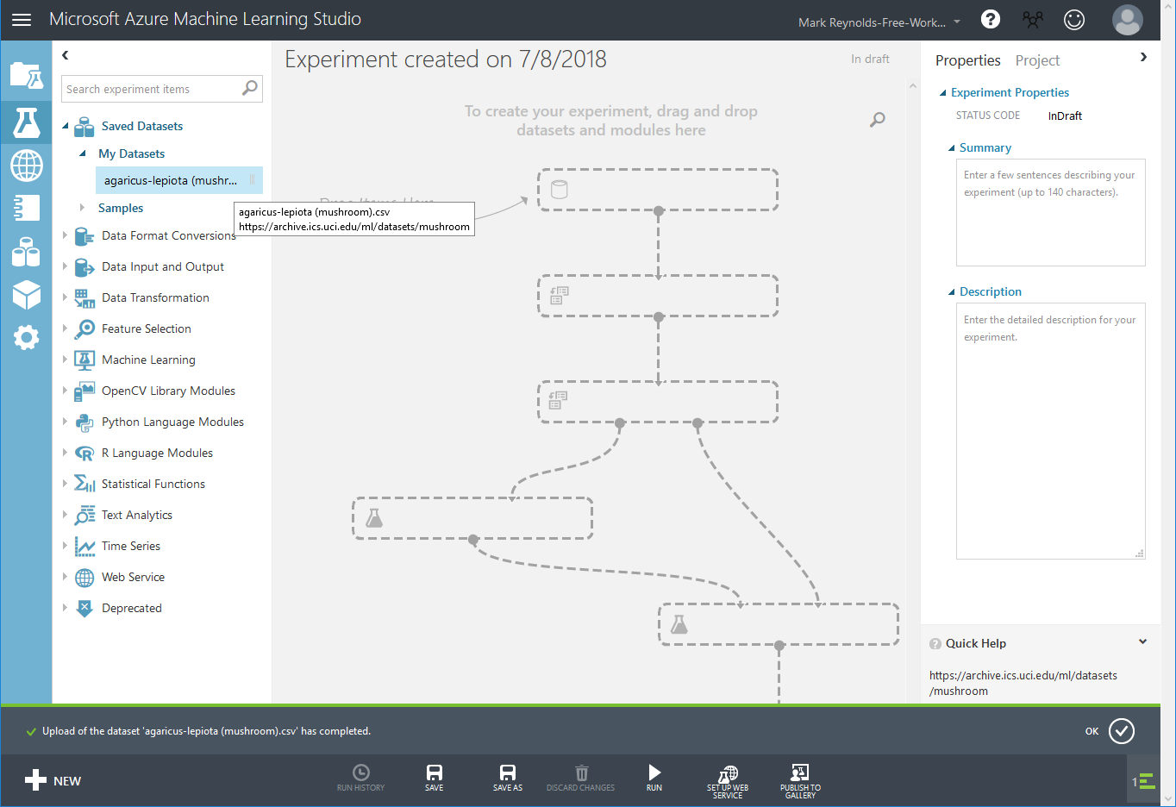
Loaded

Slide 17
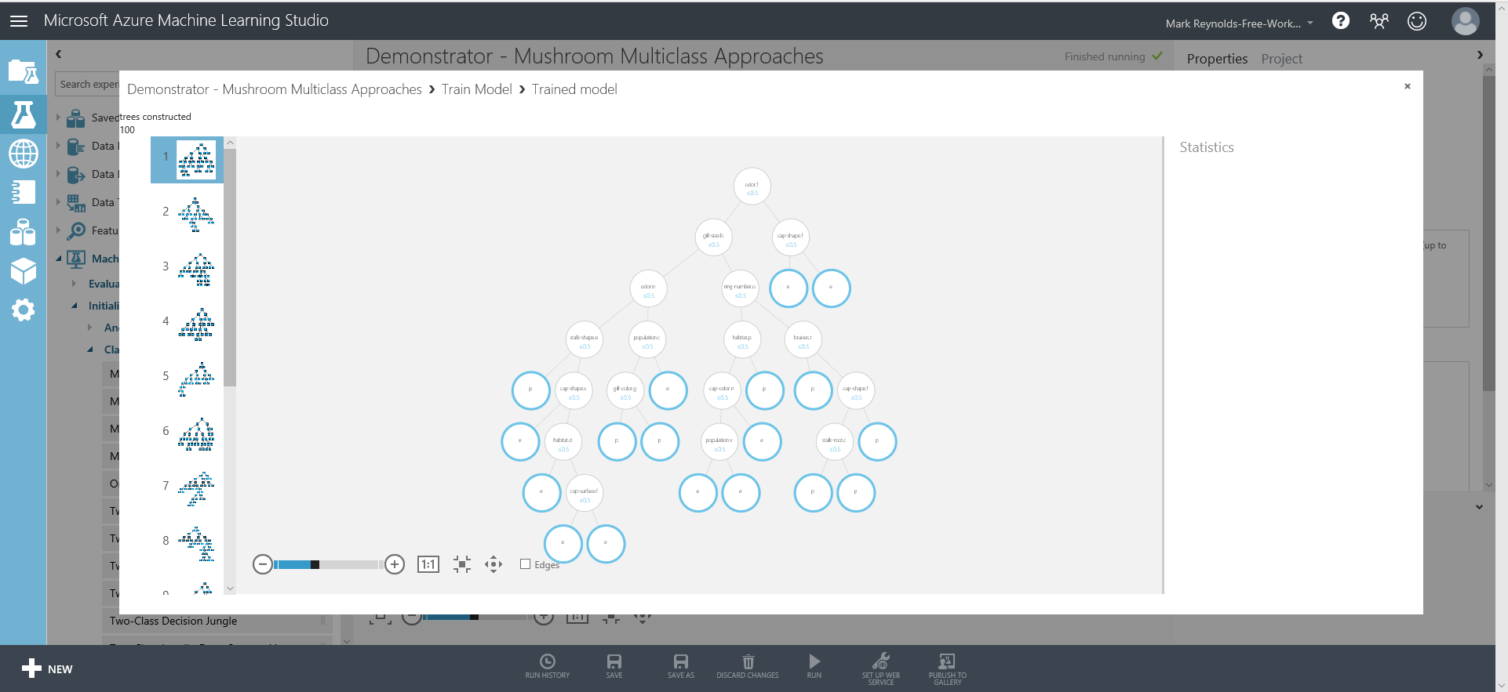
2 Class Boosted Decision Tree – Simple 100% Yes/No Model

Slide 18
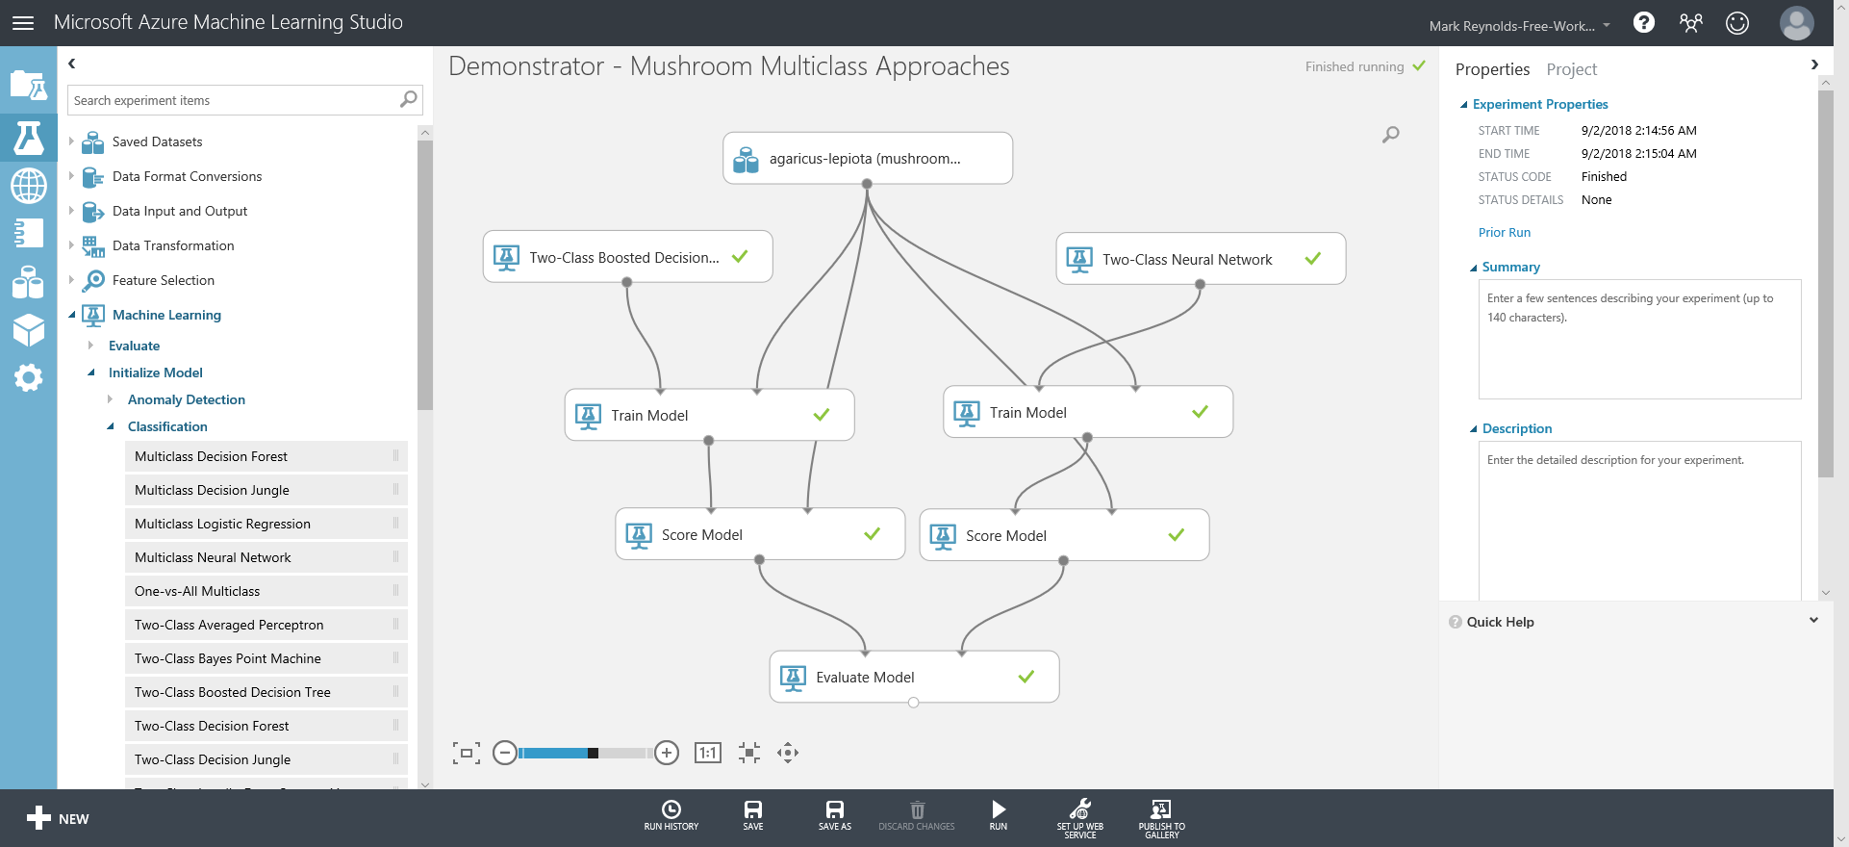
Two Class Experiment

Slide 19
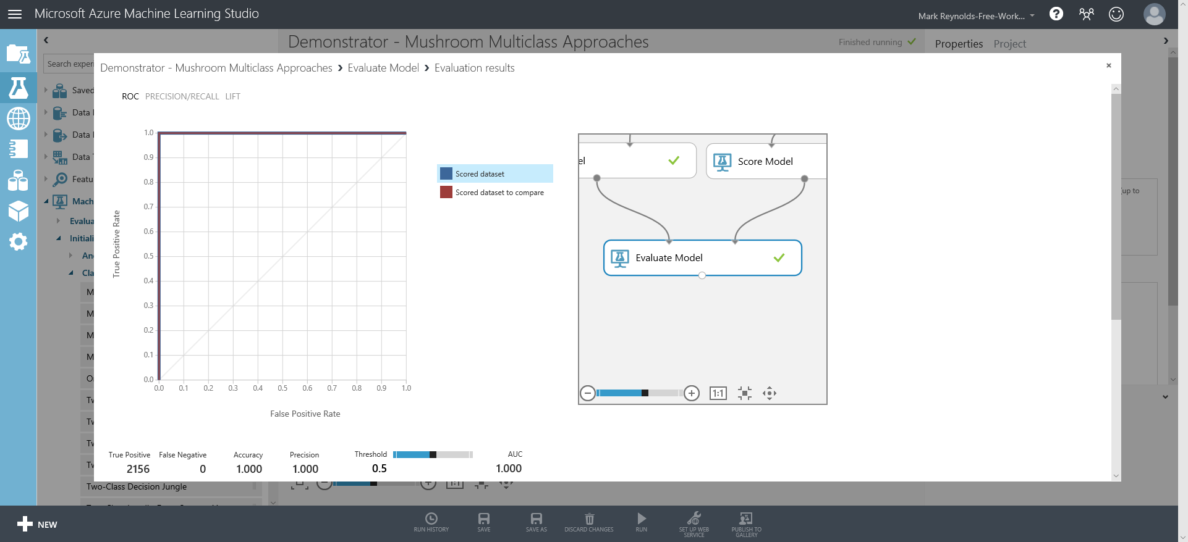
Two Class Experiment – Evaluate Model

Slide 20
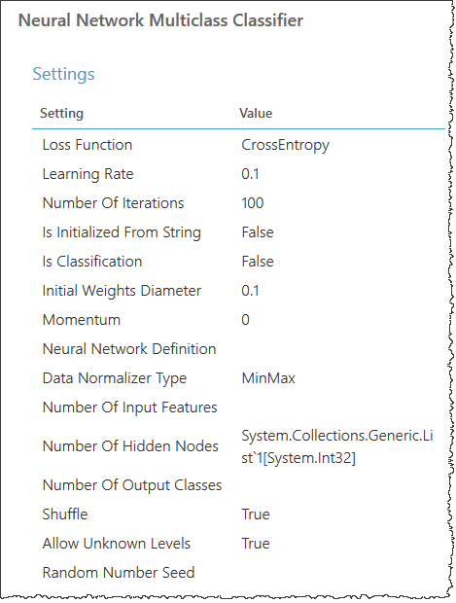
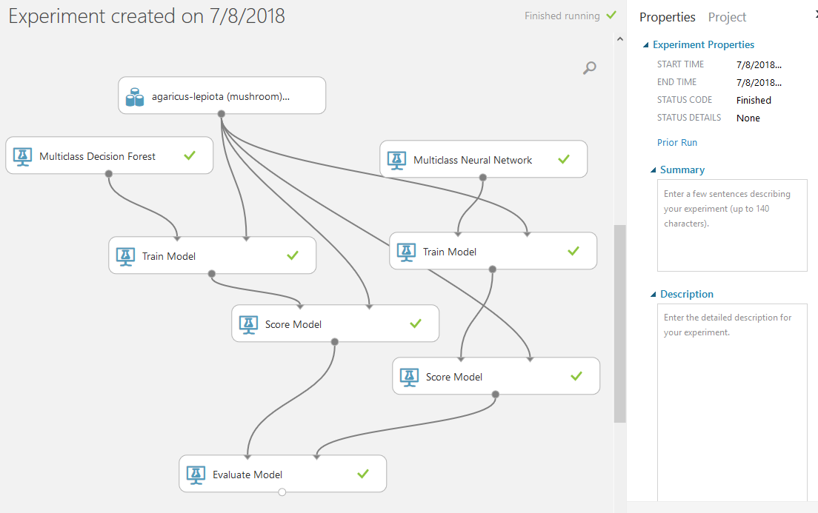
Compared to Multiclass Neural Network

Slide 21
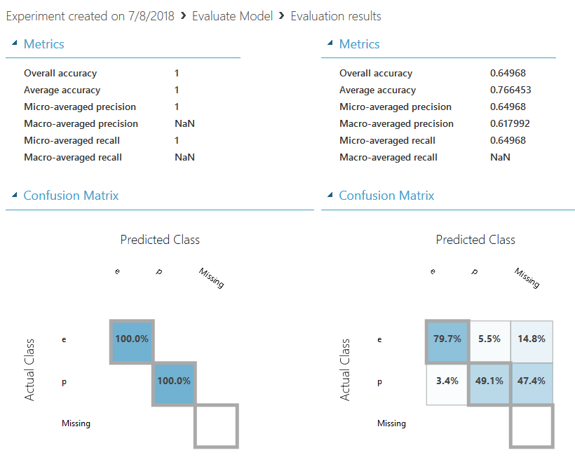
Multiclass Comparison

Slide 22
Classification Machine Learning Definitions
Multiclass Decision Forest
Decision trees
Branch until resolved
Multiclass Decision Jungle
Branches may merge
Multiclass Logistic Regression
predict the probability of an outcome
Multiclass Neural Network
One-vs-All Multiclass
predicts three or more possible outcomes
Two-Class Averaged Perceptron
Early & very simple neural network
Suited to linearly separable patterns
Two-Class Bayes Point Machine
Finds one "average" classifier - Bayes Point
Two-Class Boosted Decision Tree
2nd tree corrects for errors of the 1st tree
Two-Class Decision Forest
Two-Class Decision Jungle
Two-Class Locally Deep Support Vector Machine
Two-Class Logistic Regression
Two-Class Neural Network
Two-Class Support Vector Machine
Source: https://docs.microsoft.com/en-us/azure/machine-learning/studio-module-reference/

Slide 23
Clustering Machine Learning Definitions
K-Means Clustering
Uses iterative techniques … … to group cases in a dataset into … … clusters that … … contain similar characteristics
Used for
Detecting abnormal data
Clustering of text documents
Pre-analysis od dataset
Source: https://docs.microsoft.com/en-us/azure/machine-learning/studio-module-reference/

Slide 24
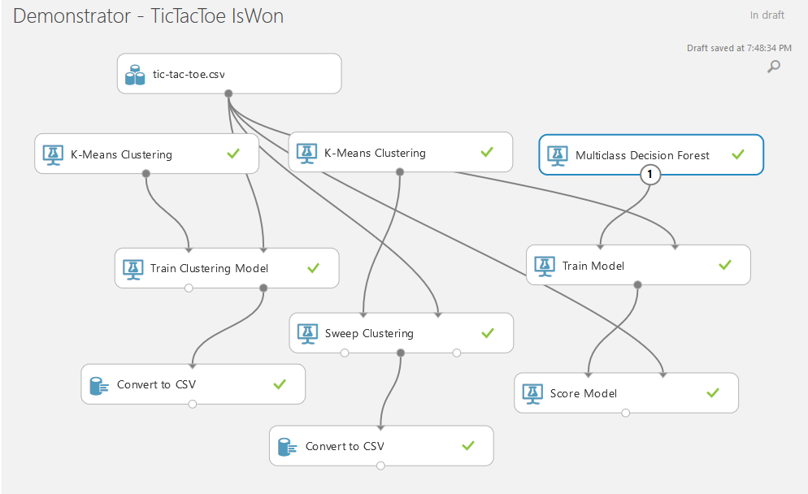
Clustering vs Classification TicTacToe

Slide 25
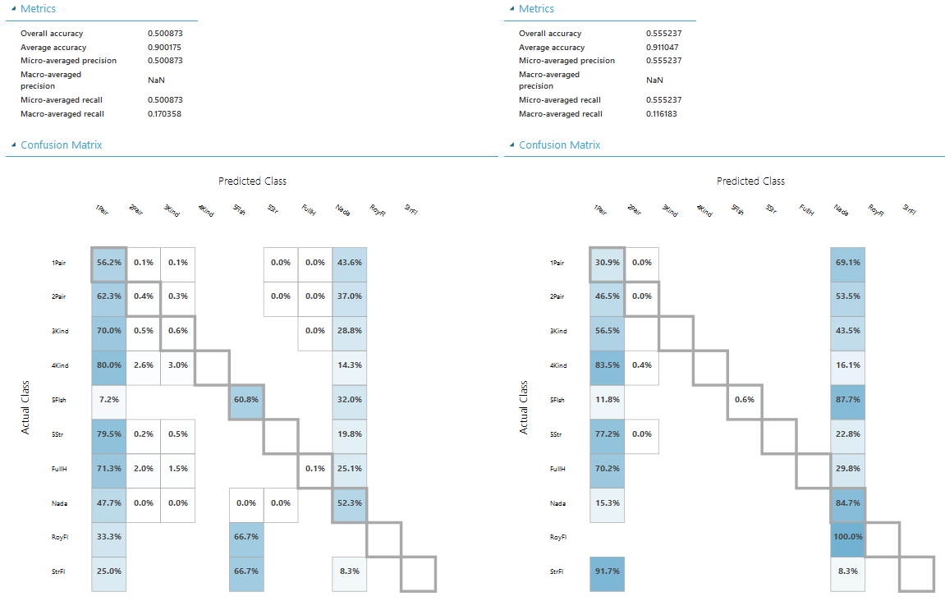
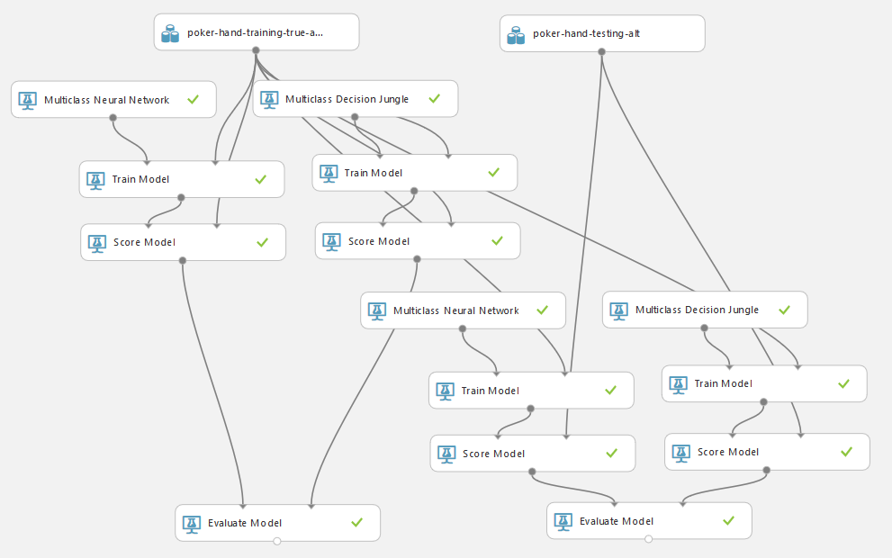
Unresolved Poker Hands

Slide 26
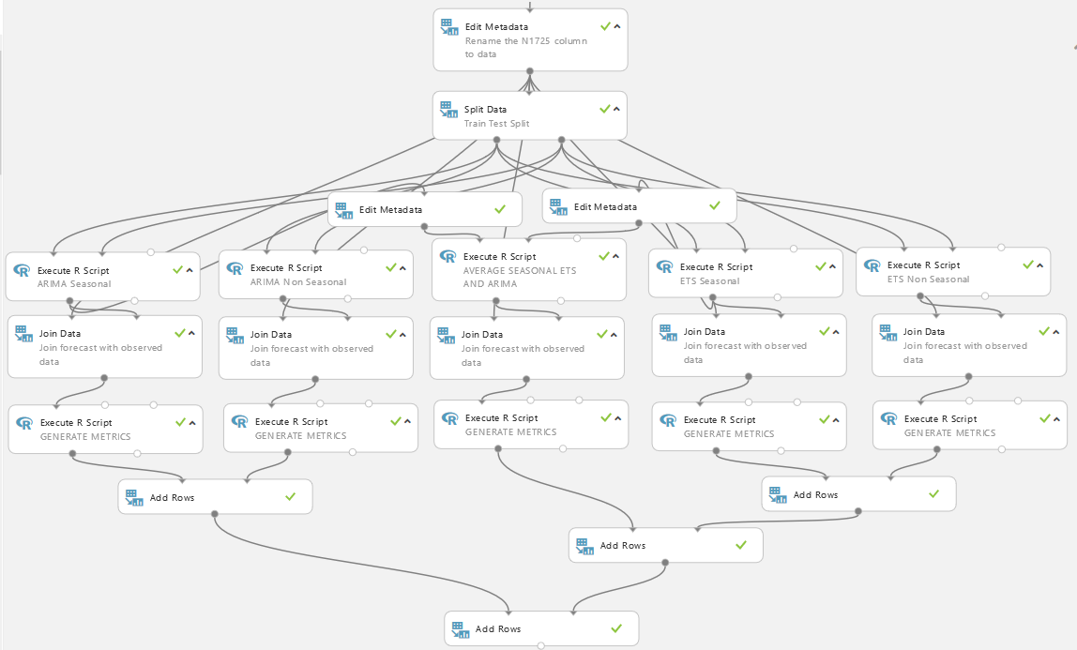
Time Series Example Project

Slide 27
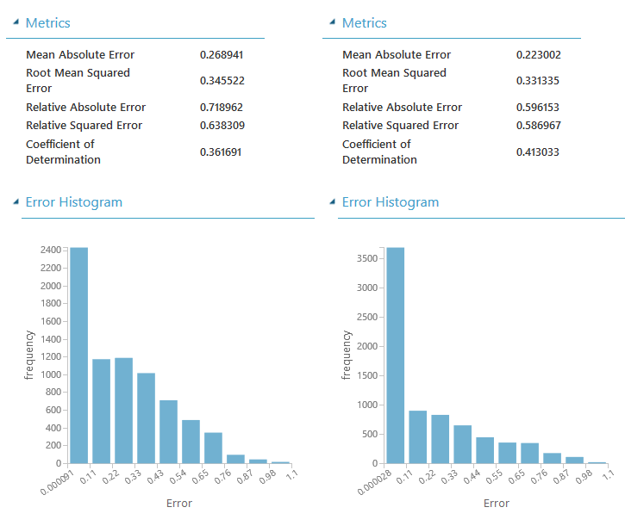
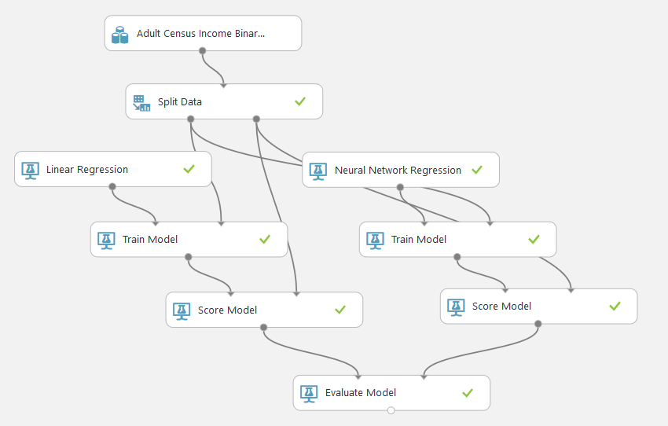
Simple Neural Regression

Slide 28

Azure Machine Learning

Slide 29
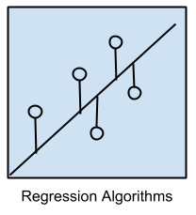
Regression Algorithms
Ordinary Least Squares Regression (OLSR)
Linear Regression
Logistic Regression
Stepwise Regression
Multivariate Adaptive Regression Splines (MARS)
Locally Estimated Scatterplot Smoothing (LOESS)
Source: https://machinelearningmastery.com/a-tour-of-machine-learning-algorithms/

Slide 30
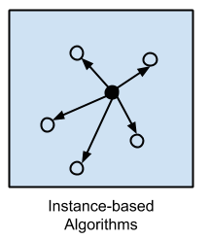
Instance-based Algorithms
k-Nearest Neighbor (kNN)
Learning Vector Quantization (LVQ)
Self-Organizing Map (SOM)
Locally Weighted Learning (LWL)
Source: https://machinelearningmastery.com/a-tour-of-machine-learning-algorithms/

Slide 31
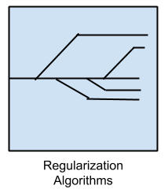
Regularization Algorithms
Ridge Regression
Least Absolute Shrinkage and Selection Operator (LASSO)
Elastic Net
Least-Angle Regression (LARS)
Source: https://machinelearningmastery.com/a-tour-of-machine-learning-algorithms/

Slide 32
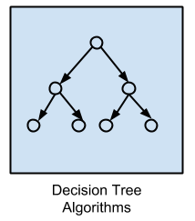
Decision Tree Algorithms
Classification and Regression Tree (CART)
Iterative Dichotomiser 3 (ID3)
C4.5 and C5.0 (different versions of a powerful approach)
Chi-squared Automatic Interaction Detection (CHAID)
Decision Stump
M5
Conditional Decision Trees
Source: https://machinelearningmastery.com/a-tour-of-machine-learning-algorithms/

Slide 33
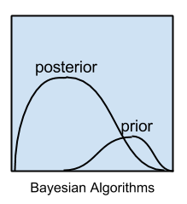
Bayesian Algorithms
Naive Bayes
Gaussian Naive Bayes
Multinomial Naive Bayes
Averaged One-Dependence Estimators (AODE)
Bayesian Belief Network (BBN)
Bayesian Network (BN)
Source: https://machinelearningmastery.com/a-tour-of-machine-learning-algorithms/

Slide 34
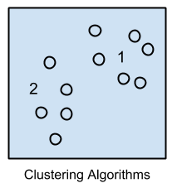
Clustering Algorithms
k-Means
k-Medians
Expectation Maximisation (EM)
Hierarchical Clustering
Source: https://machinelearningmastery.com/a-tour-of-machine-learning-algorithms/

Slide 35
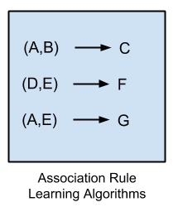
Association Rule Learning Algorithms
Apriori algorithm
Eclat algorithm
Source: https://machinelearningmastery.com/a-tour-of-machine-learning-algorithms/

Slide 36
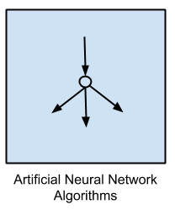
Artificial Neural Network Algorithms
Perceptron
Back-Propagation
Hopfield Network
Radial Basis Function Network (RBFN)
Source: https://machinelearningmastery.com/a-tour-of-machine-learning-algorithms/

Slide 37
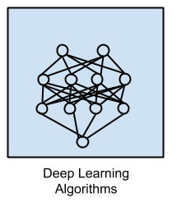
Deep Learning Algorithms
Deep Boltzmann Machine (DBM)
Deep Belief Networks (DBN)
Convolutional Neural Network (CNN)
Stacked Auto-Encoders
Source: https://machinelearningmastery.com/a-tour-of-machine-learning-algorithms/

Slide 38
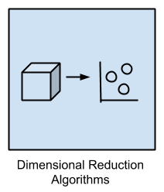
Dimensionality Reduction Algorithms
Principal Component Analysis (PCA)
Principal Component Regression (PCR)
Partial Least Squares Regression (PLSR)
Sammon Mapping
Multidimensional Scaling (MDS)
Projection Pursuit
Linear Discriminant Analysis (LDA)
Mixture Discriminant Analysis (MDA)
Quadratic Discriminant Analysis (QDA)
Flexible Discriminant Analysis (FDA)
Source: https://machinelearningmastery.com/a-tour-of-machine-learning-algorithms/

Slide 39
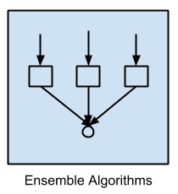
Ensemble Algorithms
Boosting
Bootstrapped Aggregation (Bagging)
AdaBoost
Stacked Generalization (blending)
Gradient Boosting Machines (GBM)
Gradient Boosted Regression Trees (GBRT)
Random Forest
Source: https://machinelearningmastery.com/a-tour-of-machine-learning-algorithms/

Slide 40
Algorithms from Specialty Subfields in ML
Computational intelligence (evolutionary algorithms, etc.)
Computer Vision (CV)
Natural Language Processing (NLP)
Recommender Systems
Reinforcement Learning
Graphical Models
…
Source: https://machinelearningmastery.com/a-tour-of-machine-learning-algorithms/

Slide 41
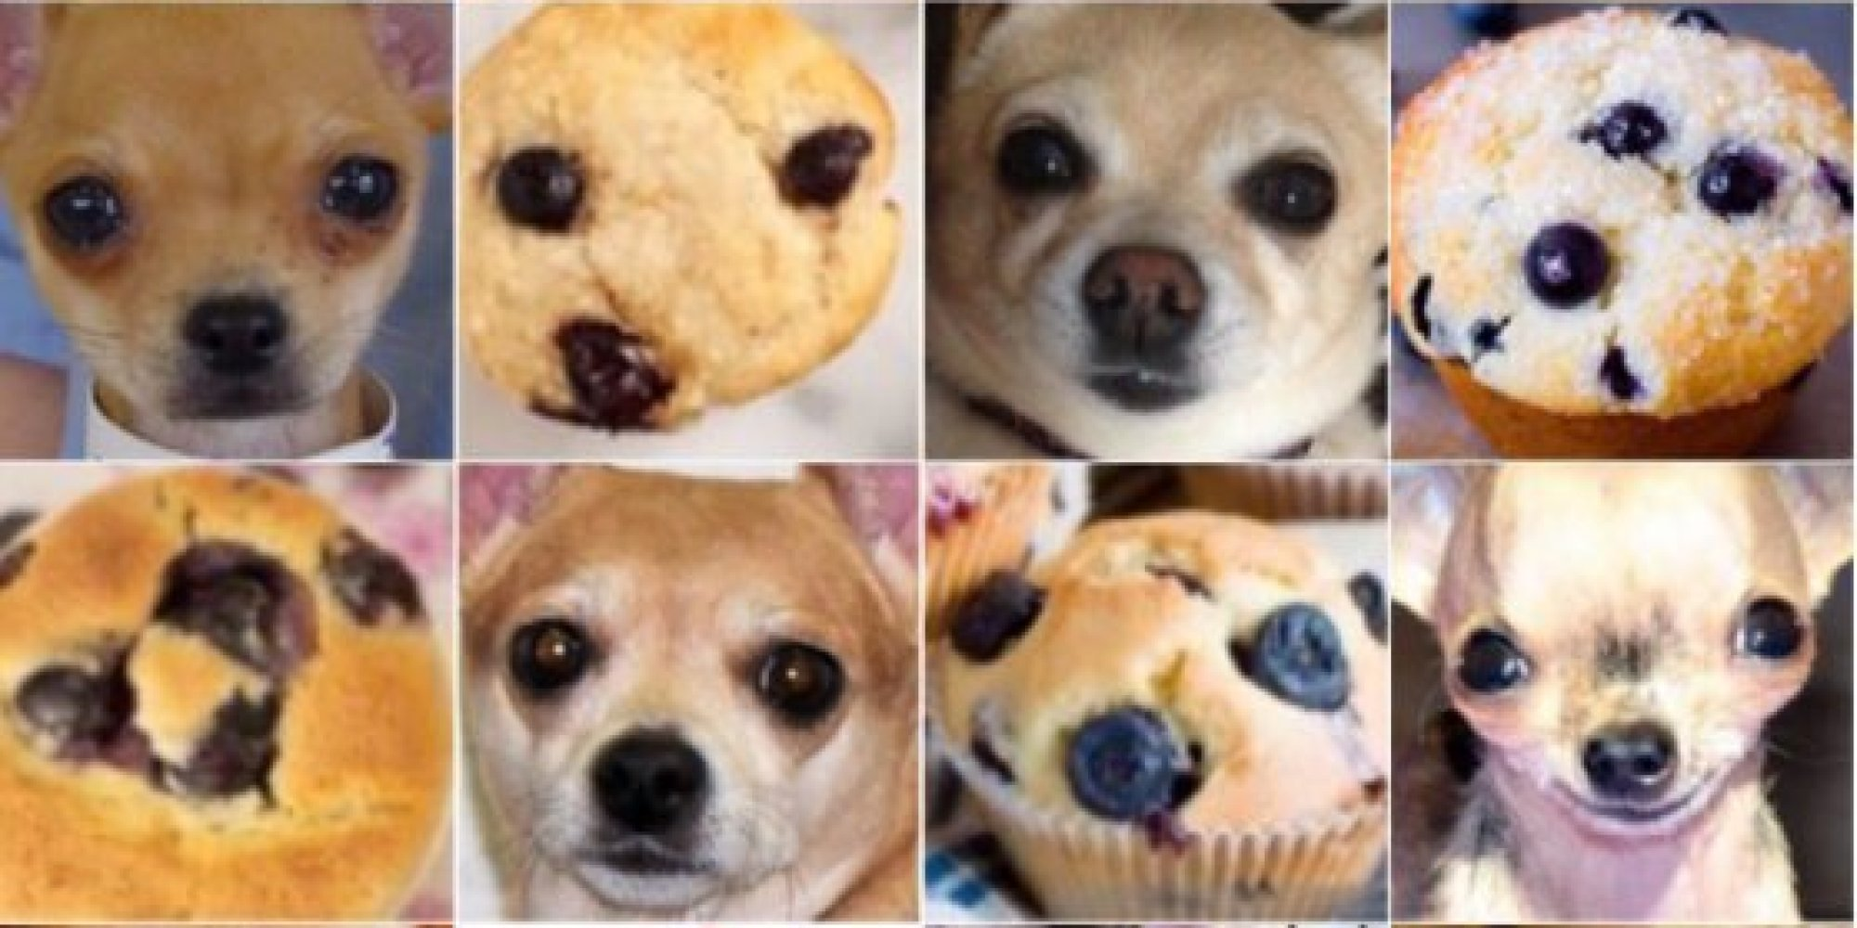
Chihuahua or Muffin?

Slide 42
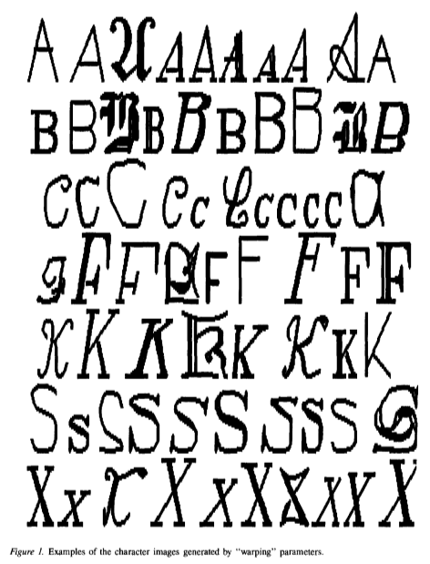
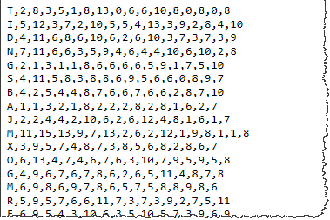
Letter Recognition Using Holland-style Adaptive Classifiers
Attribute Information:
lettr capital letter (26 values from A to Z)
x-box horizontal position of box (integer)
y-box vertical position of box (integer)
width width of box (integer)
high height of box (integer)
onpix total # on pixels (integer)
x-bar mean x of on pixels in box (integer)
y-bar mean y of on pixels in box (integer)
x2bar mean x variance (integer)
y2bar mean y variance (integer)
xybar mean x y correlation (integer)
x2ybr mean of x * x * y (integer)
xy2br mean of x * y * y (integer)
x-ege mean edge count left to right (integer)
xegvy correlation of x-ege with y (integer)
y-ege mean edge count bottom to top (integer)
yegvx correlation of y-ege with x (integer)
Source: http://archive.ics.uci.edu/ml/machine-learning-databases/letter-recognition/letter-recognition.names

Slide 43
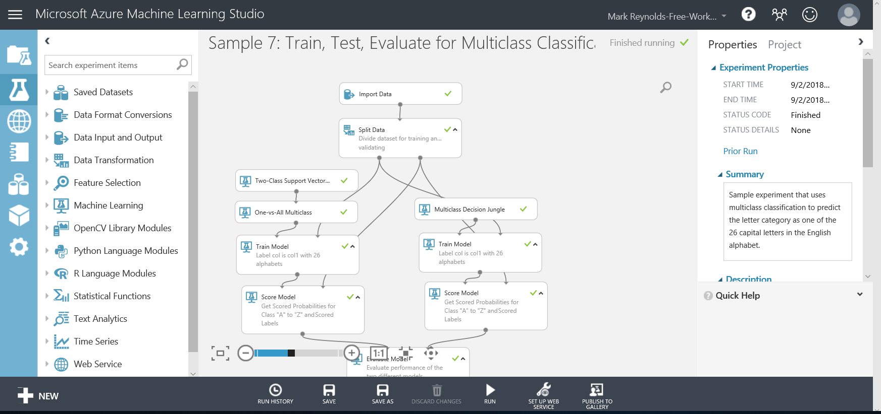
Letter Recognition Using Holland-style Adaptive Classifiers

Slide 44
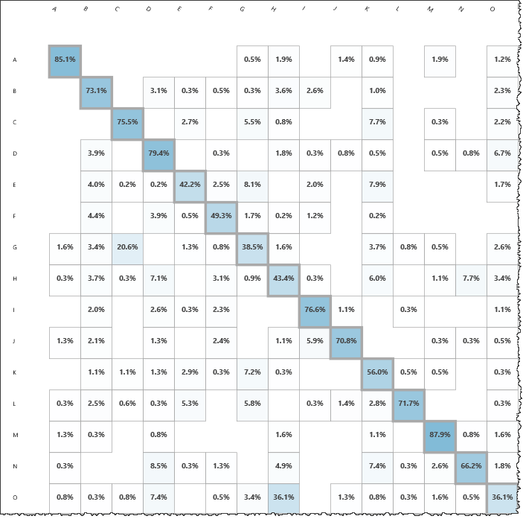
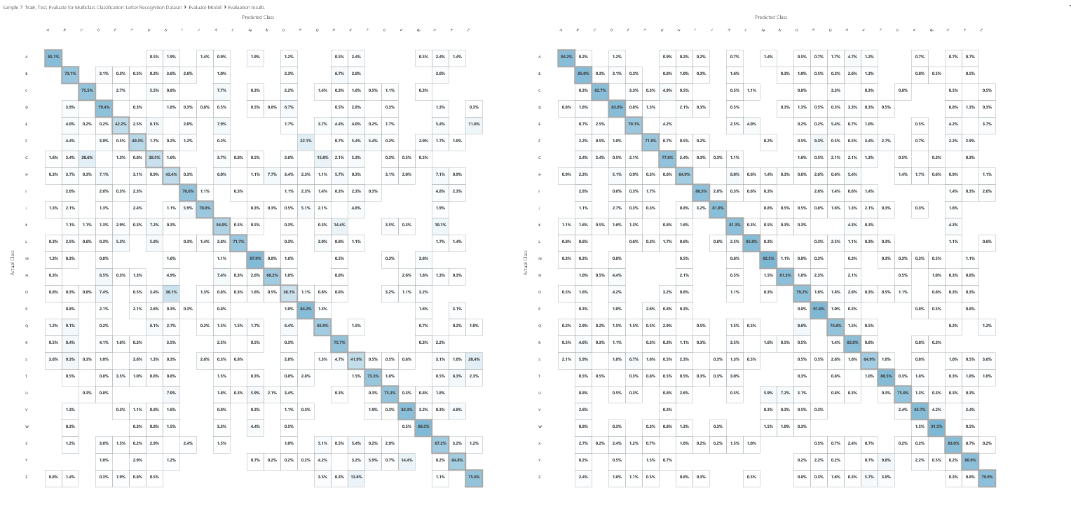
Letter Recognition Using Holland-style Adaptive Classifiers

Slide 45
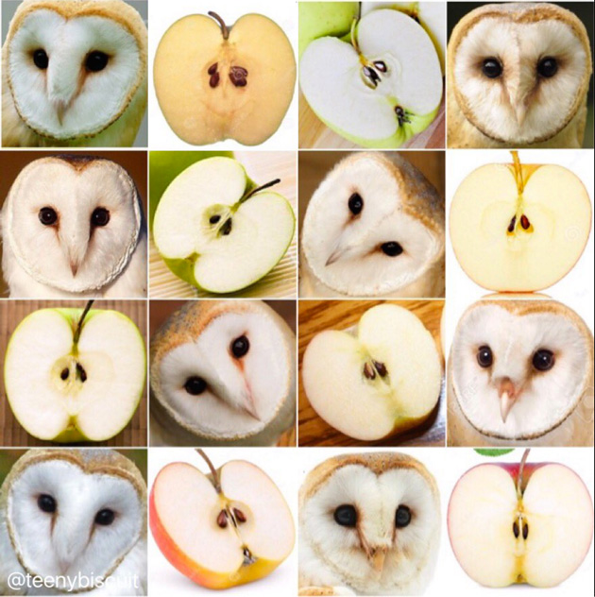
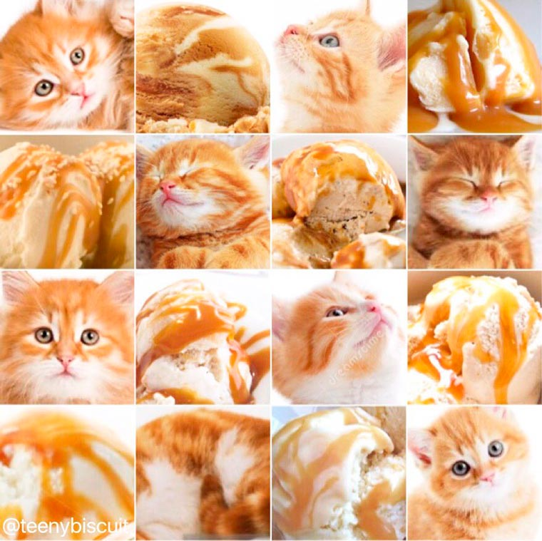
Barn Owl or Apple?

Slide 46
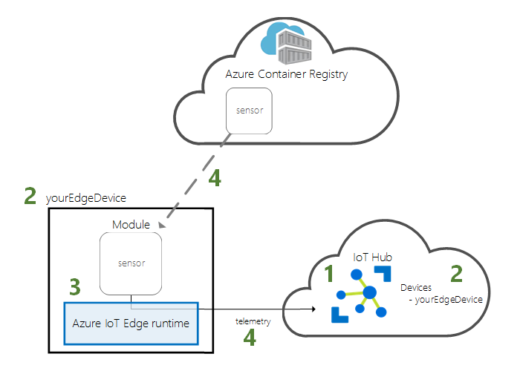
Microsoft’s IoT-Edge
Create an IoT Hub.
Register an IoT Edge device to your IoT hub.
Install and start the IoT Edge runtime on your device.
Remotely deploy a module to an IoT Edge device and send telemetry to IoT Hub.
Source: https://docs.microsoft.com/en-us/azure/iot-edge/quickstart

Slide 47
Keep Your Eye on the Prize
Knowledge
Data
Information
Understanding
Wisdom
Application
The question is NOT
“How can we … ?”
But instead
“What is the objective?”
( or “Why?” )

Slide 48
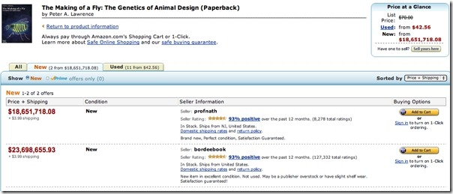
And – Keep Your Eye on the Machine
Source: https://blogs.wsj.com/tech-europe/2011/04/26/for-sale-the-making-of-a-fly-only-23698655-93-plus-3-99-shipping/

Slide 49
Important URLs
https://studio.azureml.net/
https://docs.microsoft.com/en-us/azure/machine-learning/
https://docs.microsoft.com/en-us/azure/machine-learning/studio/
https://gallery.azure.ai/browse
https://portal.azure.com/
https://azure.microsoft.com/en-us/
https://azure.microsoft.com/en-us/solutions/
https://docs.microsoft.com/en-us/azure/iot-edge/

Slide 50

Mark Reynolds
Mark Reynolds Vitae
TBD
Southwestern Energy
Lone Star College
Intent Driven Designs
Scan Systems
Sikorsky Aircraft
General Dynamics
Personal Email: mark@DataDriven.Energy
Linkedin: www.linkedin.com/in/ProfReynolds
Twitter: @Prof_Reynolds
http://ProfReynolds.com

